Slide 1
A TECHNICAL REPORT ON STUDENTS’ INDUSTRIAL WORK EXPERIENCE SCHEME (S.I.W.E.S) DONE AT MINISTRY OF ECONOMIC DEVELOPMENT AND IBOM DEEP SEAPORT, UYO, AKWAIBOM STATE. PERIOD OF ATTACHMENT OCTOBER 2021 – JANUARY 2022 BY CHINEDU EBERECHUKWU QUEENSLEY REG NO: 2018524121 SUBMITTED TO DEPARTMENT OF INDUSTRIAL MATHEMATICS FACULTY OF PHYSICAL SCIENCES NNAMDI AZIKIWE UNIVERSITY, AWKA. BEING A REPORT SUBMITTED IN PARTIAL FULFILMENT OF THE REQUIREMENTS FOR THE STUDENTS INDUSTRIAL WORK EXPERIENCE SCHEME.

Slide 2
ABSTRACT
This technical report depicts and presents the experience acquired at the Ministry of Economic Development and Ibom Deep Seaport, Uyo as a SIWES student. The report discusses the working experience gained during my Industrial Training where I served with the staff of the department of price statistics. The statistical package used in this report is Microsoft Excel. The type of data used is secondary data and statistical tools are regression and correlation. The aim and objective of the analysis is to determine and forecast the Consumer Price Index (CPI) for food in the state of Akwaibom and to deduce the nature of relationship between prices in the different senatorial district.

Slide 3
Brief history of Ministry of Economic Development
The Ministry was created as Ministry of Economic Development and Project Monitoring on 3rd July, 2002, from the then Ministry of Finance and Economic Development.
In August 2003, it was renamed Ministry of Economic Development and in 2016 was again renamed Ministry of Economic Development, Labour and Manpower Planning. Today, the Ministry is known as Ministry of Economic Development and Ibom Deep Seaport.
One of the functions of this ministry is that it ensures that the relevant role players maintain discipline in the development and management of an emerging economy of Akwa Ibom State in the South-South geopolitical zone of Nigeria, strategically located along the coast lines of the Gulf of Guinea within the West African Sub-region.

Slide 4
WORK EXPERIENCE
I worked in the department of price statistics under Mr Ese Nkereuwem Solomon. I learnt how to sort, compile and clean data. I was trained in the use of MS-Excel and its data imputation, analysis, presentation and interpretation.
Apart from the usual work experiences, I have also learnt some good work morals such as:
1.Essence of punctuality at work
2.Office code of conduct
3.Proper management of the human and material resources

Slide 5
RESEARCH METHODOLOGY
Data Collection
The data used in this report is of secondary sources. Prices of goods in various local governments in Akwa Ibom State gotten from the department of Price Statistics under the Ministry of Economic Development, Uyo.
Aim and Objectives Of The Analysis
To determine how the consumer price index (CPI) for food changes quarterly, using Index numbers
To forecast the consumer price index (CPI) for food in the first and second quarter of the year 2022, using regression analysis
To determine the nature of the relationship of prices of food stuff in the different senatorial districts, using correlation

Slide 6
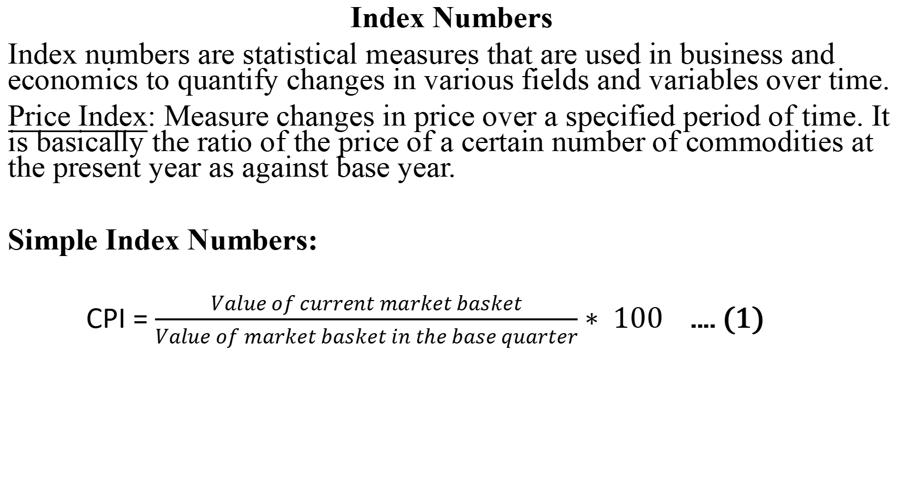
Index Numbers
Index numbers are statistical measures that are used in business and economics to quantify changes in various fields and variables over time.
Price Index: Measure changes in price over a specified period of time. It is basically the ratio of the price of a certain number of commodities at the present year as against base year.
Simple Index Numbers:
CPI = $\frac{Value of current market basket}{Value of market basket in the base quarter}∗ 100$ .... (1)

Slide 7
Regression
This is a statistical tool used to determine the mathematical relationship that exists between two or more variables.
•Simple linear regression
This shows the mathematical relationship that exists between two variables, that is the dependent variable (Y) and the independent variable (X). The regression model is
.... (2)
Y _{i} = Dependent variable
Β ₀ = Regression constant/intercept
Β ₁ = Coefficient of independent variable x1
X _{i} = Independent variables observed in the data
e _{i} = Error term/unexplained variation

Slide 8
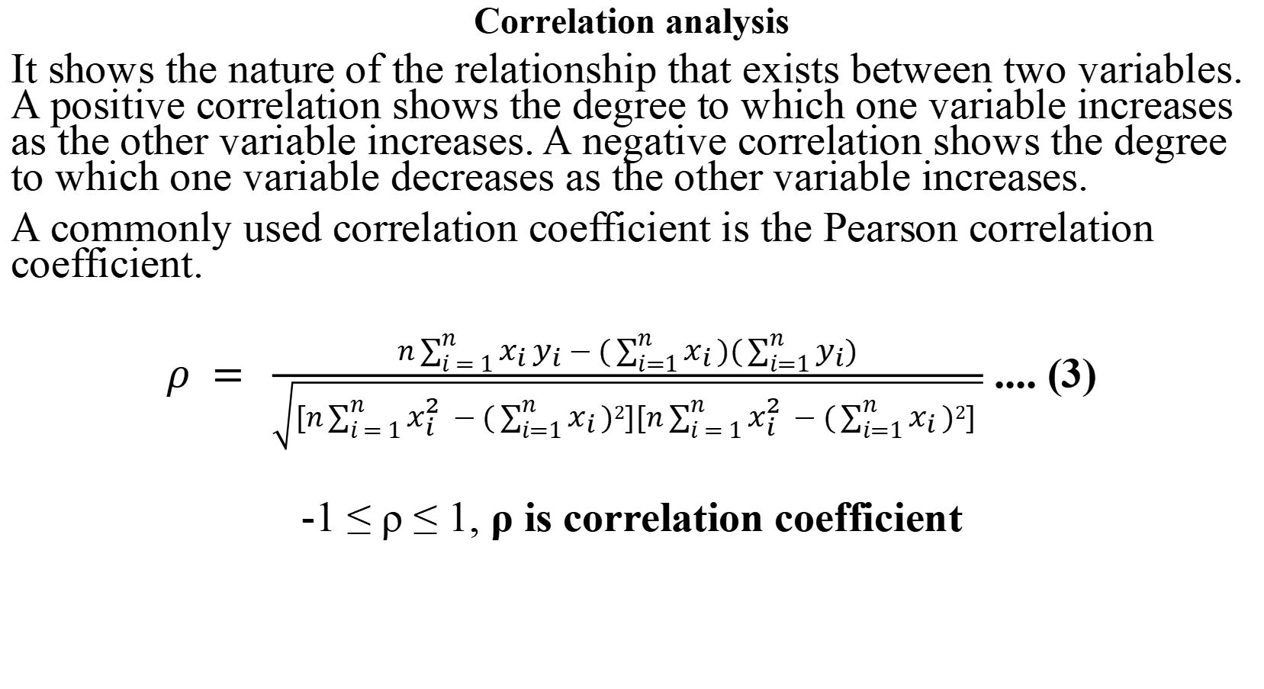
Correlation analysis
It shows the nature of the relationship that exists between two variables. A positive correlation shows the degree to which one variable increases as the other variable increases. A negative correlation shows the degree to which one variable decreases as the other variable increases.
A commonly used correlation coefficient is the Pearson correlation coefficient.
$ρ = \frac{n\sum_{i = 1}^{n}{x_{i}}y_{i} − (\sum_{i=1}^{n}{x_{i}})(\sum_{i=1}^{n}{y_{i})}}{\sqrt{[n\sum_{i = 1}^{n}{x_{i}^{2}} − (\sum_{i=1}^{n}{x_{i}})2][n\sum_{i = 1}^{n}{x_{i}^{2}} − (\sum_{i=1}^{n}{x_{i}})2] }}$ .... (3)
-1 ≤ ρ ≤ 1, ρ is correlation coefficient

Slide 9
Table 1: Average retail price of 60 selected commodities within AkwaIbom state
 | South Senatorial District | North West Senatorial District | North East Senatorial District
Garri | 24.50 | 24.50 | 25.50
Rice (local) | 66.78 | 74.46 | 73.60
Yam | 181.99 | 197.55 | 215.53
Cocoyam (white) | 152.70 | 176.98 | 190.54
Cassava | 95.00 | 97.67 | 125.30
Sweet Potato | 145.35 | 131.48 | 193.24
Plantain | 180.08 | 192.87 | 247.48
Beans (Brown) | 82.94 | 94.23 | 89.68
Groundnut (Shelled) | 117.84 | 105.94 | 111.38
Croaker (Dried) | 1046.28 | 1105.58 | 1021.95
Groundnut Oil | 372.46 | 412.06 | 420.82
Egg (Agric) | 399.43 | 416.00 | 443.99
Orange | 118.19 | 141.64 | 154.21
... | ... | ... | ...
... | ... | ... | ...
Battery | 108.46 | 106.35 | 96.50

Slide 10
Table 2: Descriptive Statistics
 | South Senatorial District | North West Senatorial District | North East Senatorial District
Mean | 330.2045615 | 325.3374712 | 317.5837106
Standard Error | 34.6687327 | 32.96185071 | 32.11668197
Median | 257.8431875 | 264.8908438 | 247.9564583
Mode | #N/A | #N/A | #N/A
Standard Deviation | 268.5428487 | 255.3213977 | 248.7747488
Sample Variance | 72115.26161 | 65189.01612 | 61888.87566
Range | 1304.667083 | 1163.376667 | 1154.117917
Minimum | 24.5 | 24.5 | 25.5
Maximum | 1329.167083 | 1187.876667 | 1179.617917
Sum | 19812.27369 | 19520.24827 | 19055.02264
Count | 60 | 60 | 60

Slide 11
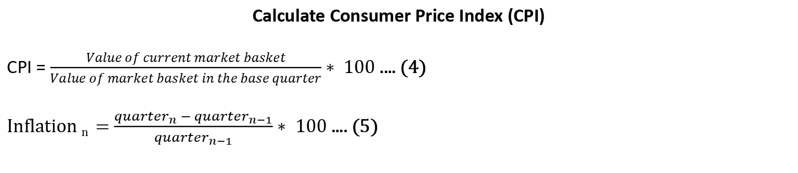
Table 3: Market basket per quarter
Quarter | n (Number of quarters) | Market Basket
1st quarter 2020 (Base Quarter) | 1 | 13000
2nd quarter 2020 | 2 | 13500
3rd quarter 2020 | 3 | 13800
4th quarter 2020 | 4 | 13900
1st quarter 2021 | 5 | 14500
2nd quarter 2021 | 6 | 15000
3rd quarter 2021 | 7 | 15300
4th quarter 2021 | 8 | 16000
Calculate Consumer Price Index (CPI)
CPI = $\frac{Value of current market basket}{Value of market basket in the base quarter}∗ 100$ .... (4)
Inflation _{n} = $\frac{{quarter}_{n} − {quarter}_{n−1}}{{quarter}_{n−1}}∗ 100$ .... (5)

Slide 12
Table 4: Calculated consumer price index and inflation rate
Quarter | Market Basket | CPI for Food | Inflation Rate
1st quarter 2020(Base Quarter) | 13000 | 100.00 | N/A
2nd quarter 2020 | 13500 | 103.85 | 3.85%
3rd quarter 2020 | 13800 | 106.15 | 2.22%
4th quarter 2020 | 13900 | 106.92 | 0.72%
1st quarter 2021 | 14500 | 111.54 | 4.32%
2nd quarter 2021 | 15000 | 115.38 | 3.45%
3rd quarter 2021 | 15300 | 117.69 | 2.00%
4th quarter 2021 | 16000 | 123.08 | 4.58%

Slide 13
To forecast the Consumer Price Index (CPI) for goods/commodities for the first and second quarter of the year 2022, I will run a regression analysis on the data above coding t such that $\sum{t} = 0$
Table 5: Coding $\sum{t} = 0$
Quarter | CPI for food(Y_{t}) | t
1st quarter 2020 | 100.00 | -7
2nd quarter 2020 | 103.85 | -5
3rd quarter 2020 | 106.15 | -3
4th quarter 2020 | 106.92 | -1
1st quarter 2021 | 111.54 | 1
2nd quarter 2021 | 115.38 | 3
3rd quarter 2021 | 117.69 | 5
4th quarter 2021 | 123.08 | 7

Slide 14
Table 6: Regression Statistics
Regression Statistics
Multiple R | 0.989165
R Square | 0.978447
Adjusted R Square | 0.974855
Standard Error | 1.229766
Observations | 8
Table 7: ANOVA
ANOVA
 | df | SS | MS | F | Significance F
Regression | 1 | 411.9394 | 411.9394 | 272.3881 | 3.15E-06
Residual | 6 | 9.073954 | 1.512326
Total | 7 | 421.0134

Slide 15
Table 8: Coefficients of Regression Statistics
 | Coefficients | Standard Error | t Stat | P-value | Lower 95% | Upper 95% | Lower 95.0% | Upper 95.0%
Intercept | 110.57625 | 0.434788109 | 254.3221579 | 2.49398E-13 | 109.5123618 | 111.6401382 | 109.5123618 | 111.6401382
X Variable 1 | 1.565892857 | 0.094878544 | 16.50418309 | 3.15423E-06 | 1.333733424 | 1.79805229 | 1.333733424 | 1.79805229
Below is the regression model:
Y _{t} = 110.58 + 1.566_{i}
Y = Consumer Price Index (CPI) for food in Naira
t = The ith quarter of the year
From the analysis above, we have our R² as 0.978 which is 97.8%. That is 97.8% of the fluctuation in the dependent variable CPI can be explained by the independent variable time.
As we move from one quarter of the year to the next, the CPI increase by 1.566 units.
•

Slide 16
TEST OF ADEQUACY OF THE MODEL
H₀: Model is not adequate
H₁: Model is adequate
Rule: If P-value is less than 0.05 (alpha level), reject H₀ and conclude
that the model is adequate and can be used to make predictions.
From the analysis above I have the p-value as 0.00000315. Hence, I have enough evidence to reject H₀ (at an alpha level of 0.05) and conclude that the model is adequate and it can be used to make predictions.
Since I have only one parameter, there’s no need to test for the adequacy of parameters.

Slide 17
CPI for food (Yt)
Consumer Price Index (CPI)
Months

Slide 18
PREDICTING THE CPI FOR FOOD FOR THE FIRST AND SECOND QUARTER OF THE YEAR 2022
For the first quarter, I set t = 9
110.58 + 1.566 (9) = 124.67
I have that in the first quarter of 2022, the CPI for food relative to the first quarter of 2020 will be 124.67 naira.
For the second quarter, I set t = 11
110.58 + 1.566 (11) = 127.81
I have that in the second quarter of 2022, the CPI for food relative to the first quarter of 2020 will be 127.81 naira.

Slide 19
Trend line showing change in CPI over time
Consumer Price Index (CPI)
Months

Slide 20
CORRELATION ANALYSIS
To check if there’s any correlation in the prices of goods among the three senatorial districts in Akwa ibom state, I ran a correlation analysis
Table 9: Correlation Table
 | South Senatorial District | North West SenatorialDistrict
North West Senatorial District | 0.982
 | 0.000
North East Senatorial District | 0.987 | 0.99
 | 0.000 | 0.000
From the correlation matrix, we see that the prices among the different senatorial districts are highly correlated.

Slide 21
Statement of hypothesis
H₀: there is no statistically significant linear relationship between prices in the different senatorial districts
H₁: there is a statistically significant linear relationship between prices in the different senatorial districts
At significance level of 0.01
Decision
At a significance level of 0.01 (two tailed), I reject the null hypothesis and conclude that the linear relationship is significant for all 3 senatorial districts
Conclusion
From the correlation matrix, we see that the prices among the different senatorial districts are highly correlated and the hypothesis test tells us that the correlation is significant.

Slide 22
Clustered column chart showing the prices of 60 selected commodities in the different senatorial districts
Price (NGN)
60 selected commodities

Slide 23
From the correlation analysis above, the prices of food stuff in the different senatorial districts are highly positively correlated and from the chart, I can conclude that they are relatively equal.

Slide 24
Conclusion
At an alpha level of 0.05, I reject the null hypothesis and conclude that the model is good for making predictions.
Between the first quarter of 2020 and the fourth quarter of 2021, the inflation rate of CPI for food increased by 21.14%
From the correlation analysis above, the prices of food stuff among the senatorial districts are strongly positively correlated and from the graph, I can conclude that they are relatively equal.

Slide 25
Recommendation
The Federal Government should look for ways to curb the steady increase in price of everyday goods and services.
Citizens should be aware of the debilitating state of the economy so as not to be caught unaware.
Since the prices of common goods are not significantly affected by the location of the LGA in AkwaIbom state, the standard of living in all senatorial districts in AkwaIbom state are relatively equal. Therefore, changing location within AkwaIbom state will most likely not have a significant effect on your savings.

Slide 26
Reference
Prof. D.N Aribodor (2020), Detailed Manual on SIWES Guidelines and Operations for Tertiary Institution, Rex Charles & Patrick Limited.
Student’s Industrial Work Experience Scheme - Mountain Top University - Empowered to Excel.” Mountain Top University in Ogun Sate, Nigeria, 2016.
Ministry’s Projects– Ministry of Economic Development and Ibom Deep Seaport.”www.aksecondev.ak.gov.ng/projects.
Vedantu. “Index Numbers.” VEDANTU, Vedantu, 18 Apr. 2020, www.vedantu.com/commerce/index-numbers
11. Correlation and Regression | the BMJ.” The BMJ | the BMJ: Leading General Medical Journal. Research. Education. www.bmj.com/about-bmj/resources-readers/publications/statistics-square-one/11-correlation-and-regression

Slide 27


